Slide 1
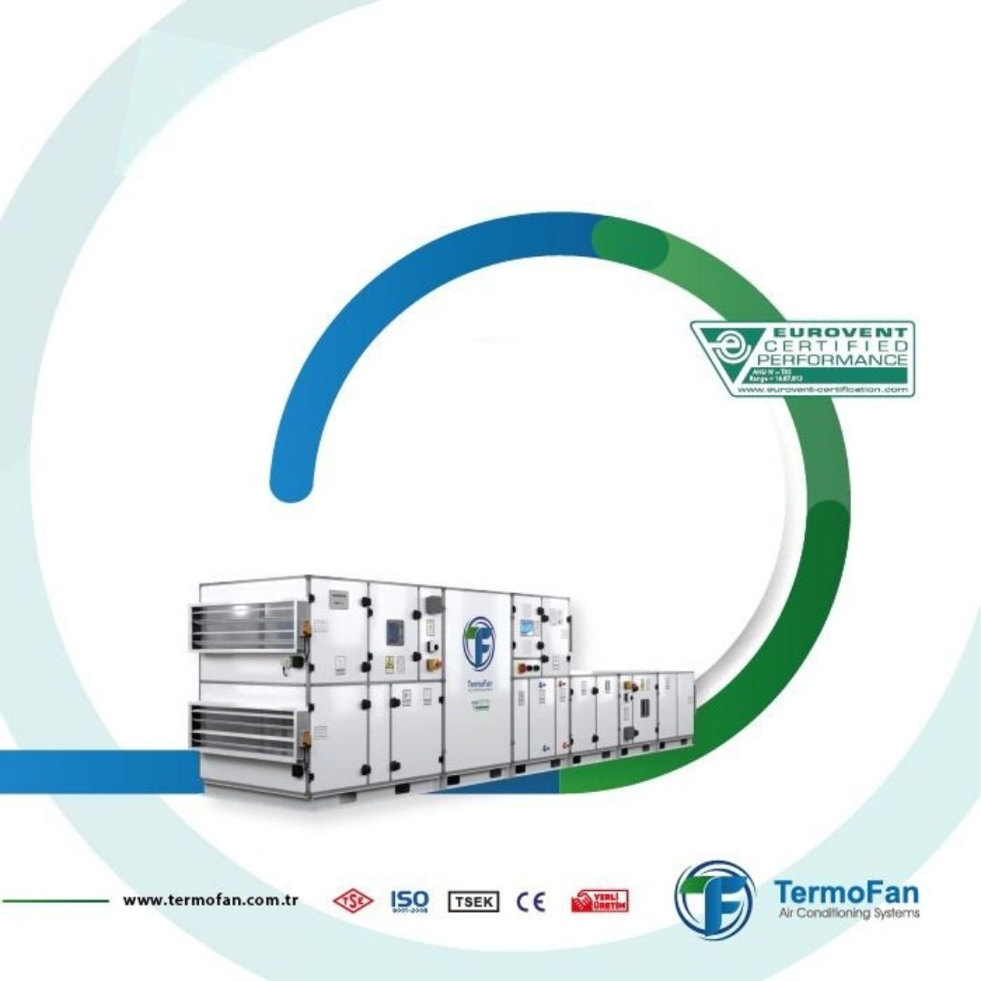


Slide 2

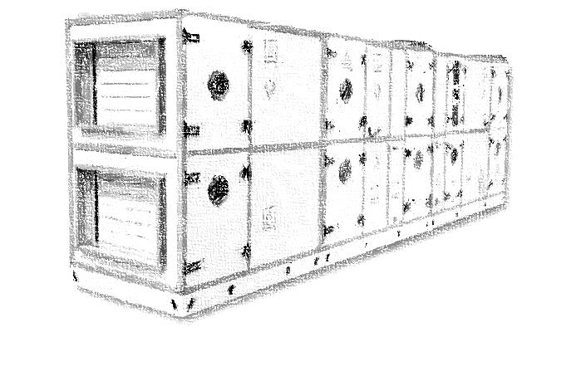

TermoFan About
It was established in 2013 as a sales office in Istanbul.
In 2014, it added the After Sales Services department to its structure.
In 2016, it started production at Kartal facilities.
In 2019, the Uzbekistan Tashkent factory became operational.
It started to serve in its new building in Tuzla in 2023.
In 2023, Termofan Morocco established in Casablanca

Slide 3
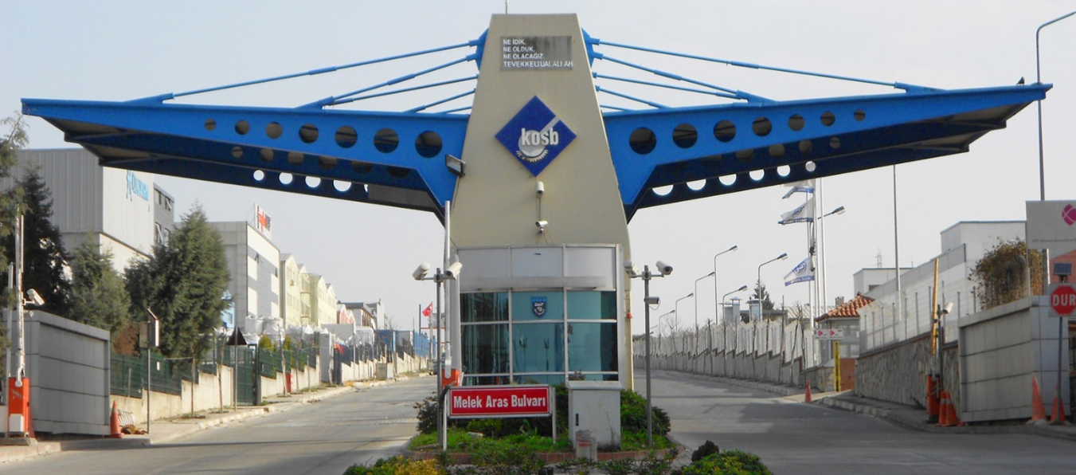
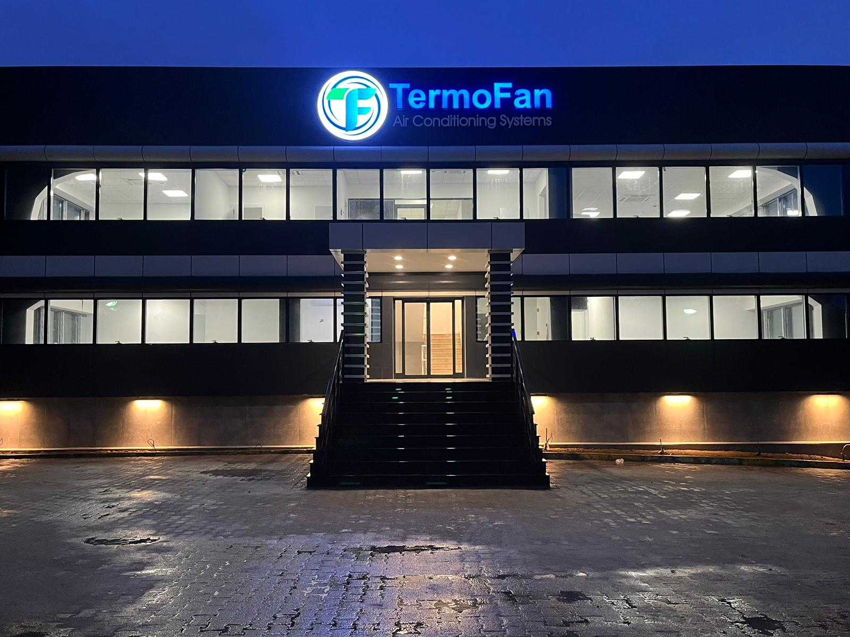
TermoFan Istanbul Factory
We continue to produce with our professional production staff and state-of-the-art machinery in our new production site with a closed production area of ​​4.750m² in the Istanbul Chemical Organized Industrial Zone, as well as in our new factory with an open area of ​​1.200m² and an office area of ​​500m²

Slide 4

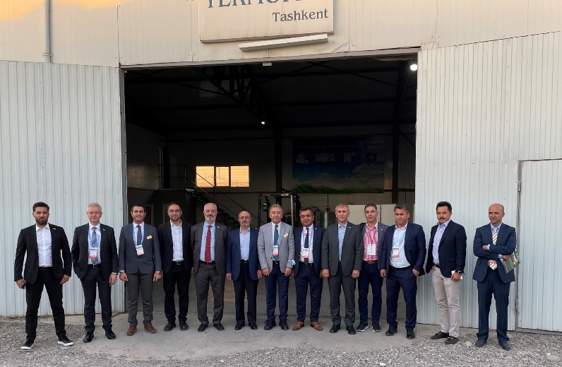
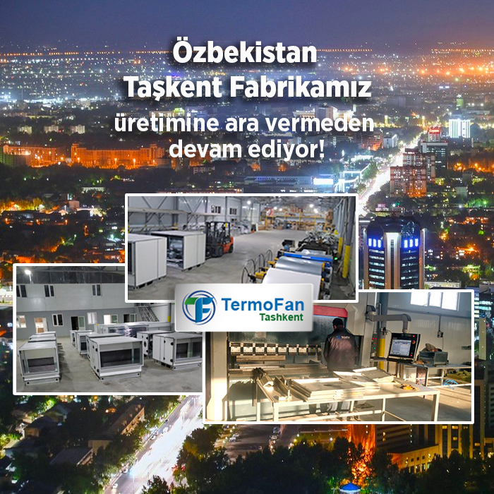
TermoFan Factories
TERMOFAN TASHKENT
It continues its production in its facility in Tashkent, built on an area of ​​2800m², 2.000m² of which is closed area.

Slide 5
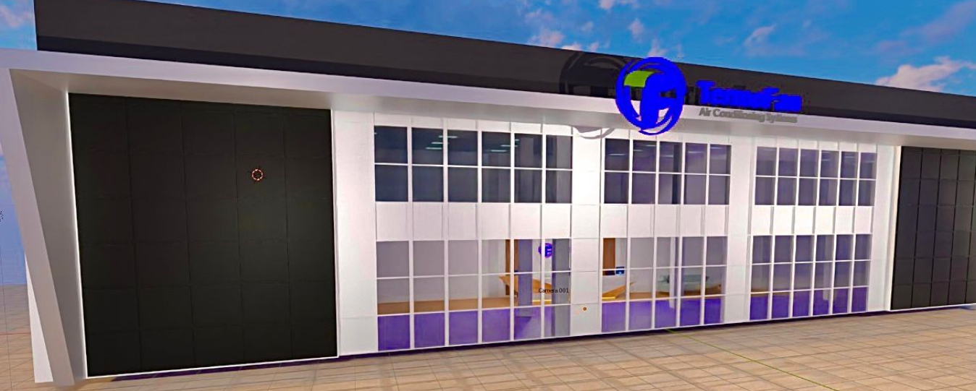
TermoFan Factories
TERMOFAN CASABLANCA
Termofan Morocco SA established in 2024 and the factory will be operated in the end of April 2025
It continues its production in its facility in Casablanca, exist on an area of ​​6500m², 4.500m² of which is closed area.

Slide 6
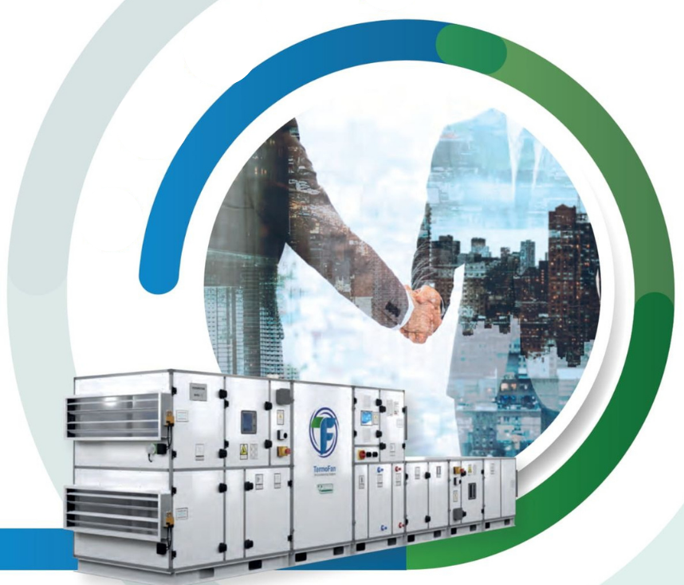


TermoFan Tajikistan
TERMODINAMIKA
A distributorship agreement was signed with the company, and the work on opening a factory in Dushanbe continues.

Slide 7
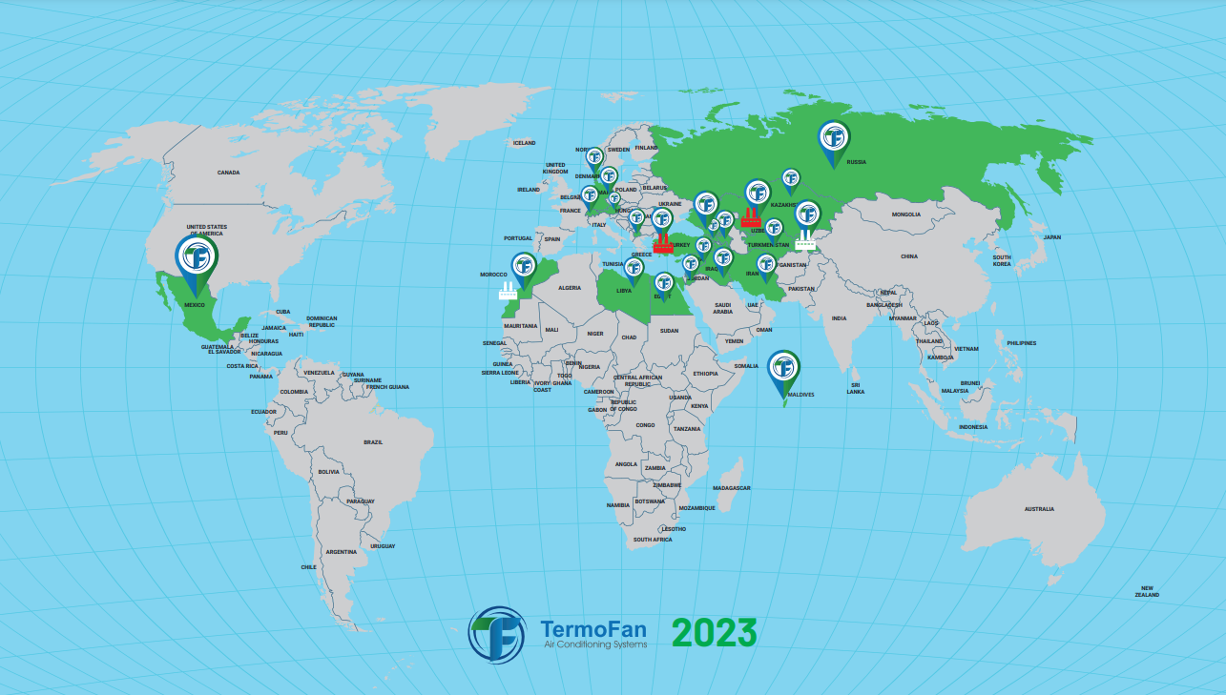
TermoFan
2023 Export Countries
Uzbekistan
Azerbaijan
Tajikistan
Georgia
Mexico
Maldives
Germany
Denmark
Switzerland
Morocco
North Macedonia
Jordan
Iraq
Iran
Libya
Palestine
United Arab Emirates
Egypt
Russia
Belarus
Kazakhstan
Turkmenistan

Slide 8
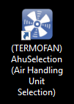
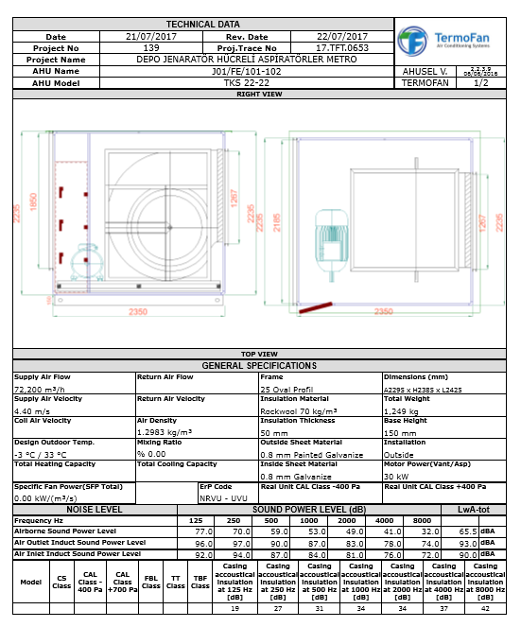
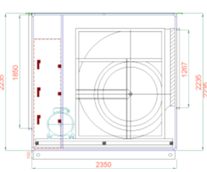
Air Handling Unit Selection Program
Klima Santrali Seçim Programı
All selections in TermoFan It is done with the EUROVENT approved selection program. Therefore, the capacity given by the elections made values ​​are 100% accurate.

Slide 9
Products
Klima Santrali Seçim Programı
Air Handling Units
%100 Fresh Air Handling Units
Air Handling Units with Heat Recovery (Rotary, Plated, Run-Around)
Air Handling Units with DX coil
Package type Air Handling Units
Heat Recovery Units
Plated type Heat Recovery Units
Heat Recovery Units with DX coil
Fans
Cell Fans
Duct type and roof type fans
Axial fans
EC type roof fans
Ecology Units

Slide 10
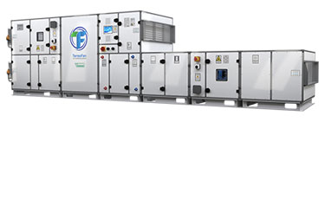
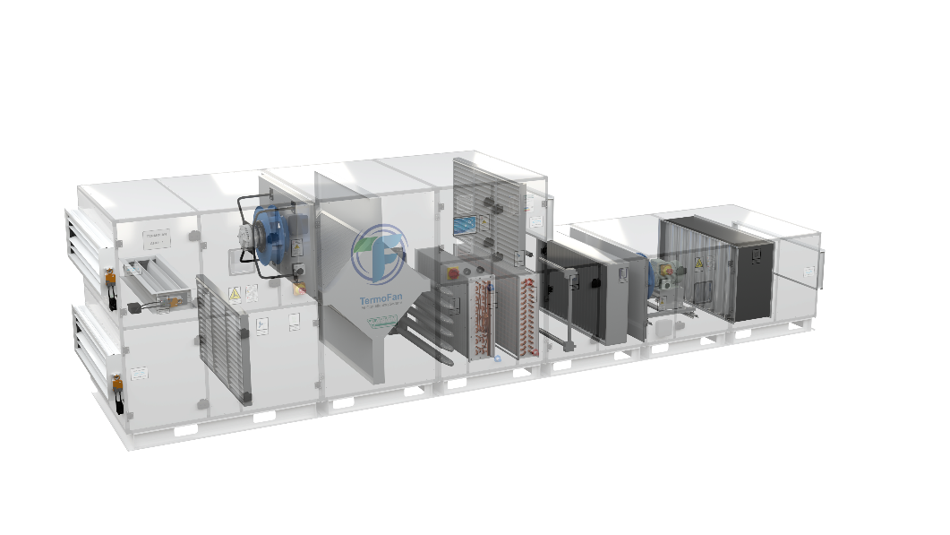
TermoFan Product
TKS
Standard Air Handling Units
Klima Santrali Seçim Programı
Termofan TKS model standard air handling units are composed of 26 different sizes ranging from 1.500 m³/h and 120.000 m³/h in air flow rates. The smallest model is TKS 7-7 outer cross-section dimensions of 710 mm x710 mm wheares the largest model is TKS 22-22 with outer dimensions of 2.235 mm x 2.235 mm. Higher air ow units can be designed with special dimensions. By joining the air intake and/or air mixing sections, filter sections, air heater and air cooler sections, humidifiers and ventilators it is possible to create tailor-made units serving different design purposes. It is also possible to make double deck executions with or without heat recovery units.
The TKS model units are produced in 26 basic sizes with air flow rates ranging from 1.500 m3/h – 120.000 m3/h. Larger units based on special designs are also possible upon request.

Slide 11
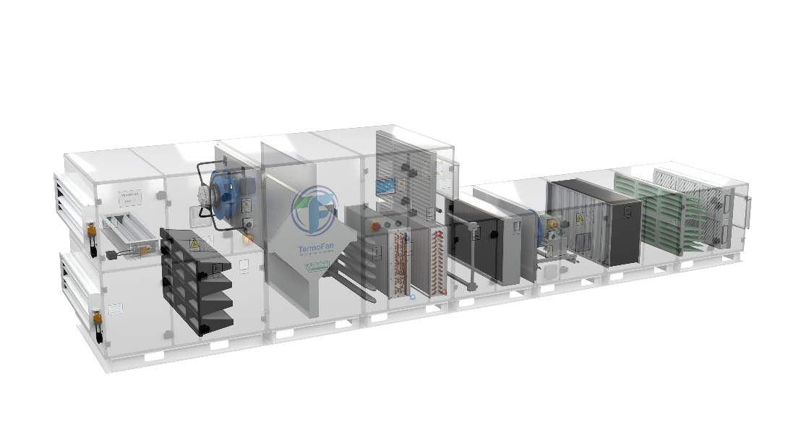
TermoFan Product
THKS
Hygienic Air Handling Units
The THKS model air handling units are designed in parallel to today’s rapidly advancing HVAC technology to meet the IAQ requirements and air-borne particule controlled enviroments such as surgical operation rooms, intensive care rooms, electronic and optical industries as classified and with VDI 2803/1 Class-0 to Class-7.
The THKS air handling units are designed and produced in conformity with DIN 1946-4 and with EN 13053. The inner surfaces of the units are completely at and they don’t have protruding pieces or particles that may cause dust accumulation. The inner parts are washable and they have a completely hygienic construction.
The location or the air filters in THKS model units vary from those in classical air handling units. In classical units the filters are located at the suction side of the supply fan before the basic elements of the system. As an obligatory item of DIN 1946-4 the coarse filters of Class G3 & G4 (previosly known as EU-3 & EU-4) are located before the supply fan, immediately after the air entrance. The fine filters which are mostly bag-type and compact filters such as F6 to F9 (previously EU-6 to EU-9) are located at the supply side of the fan after a plenum equipped with an air deflector. The H13 & H14 class HEPA filters are generally located outside the air handling unit, within the clean room immediately before the terminal supply element. But in special circumstances it is possible to place them within the air handling units after the fine filters in a specially designed housings.
Plug-fans are generally preferred in THKS model hygienic air handling units since they have very low dust concentrations on the surfaces and that they are easily cleanable. Double inlet radial fans with backward or forward curved blades are also installed in accordance with the customers’ requests.
The THKS model air handling units meet the following codes as per DIN EN-1886.
The TНKS model units are produced in 26 basic sizes with air flow rates ranging from 1.520 m3/h – 39.200 m3/h. Larger units based on special designs are also possible upon request.
Klima Santrali Seçim Programı

Slide 12
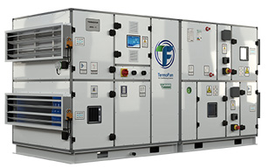
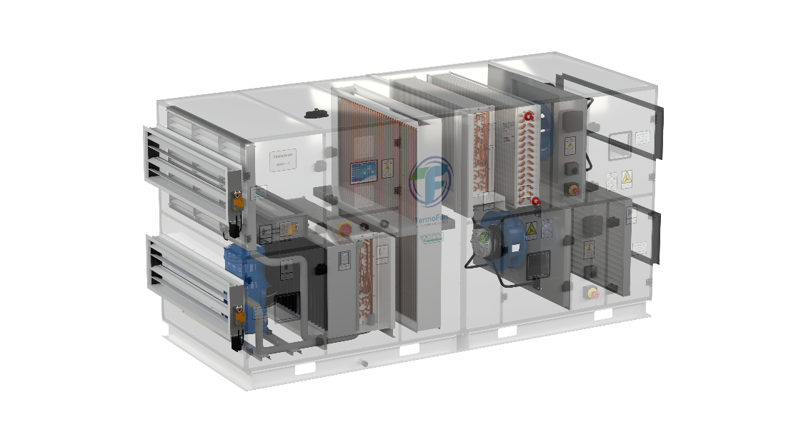
TermoFan Product
THNS
Swimming Pool Dehumidification
Air Handling Unit
Klima Santrali Seçim Programı
THNS package type units are special ventilation units designed to remove excess humidity caused by surface evaporation indoor swimming pools and ensure optimal comfort in the pool area all year round. When the relative humidity rises above 60%, it does not only affect the comfort conditions, but also causes condensation on the walls and windows, and damages all installation elements in the room. THNS series units are packaged type air conditioners designed to provide the highest comfort conditions inside the swimming pool and, if necessary, to remove high absolute humidity. Since the THNS type air conditioners are equipped with a refrigerant circuit, electrical control panel and programmable automatic control equipment, nothing is required to operate them other than the necessary electrical wiring to the installation location.
The TНNS model units are produced in 8 basic sizes with air flow rates ranging from 2.500 m3/h – 27.000 m3/h. Larger units based on special designs are also possible upon request.

Slide 13
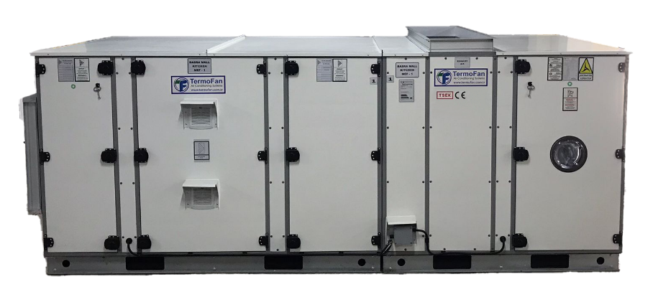
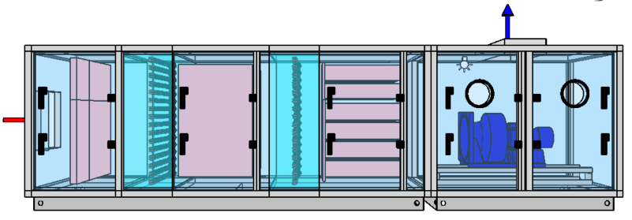
TermoFan Product
TEKU
Ecological Kitchen Unit
Klima Santrali Seçim Programı
Ecological units are ventilation equipment used to clean oily and polluted air from kitchen exhaust air and to release healthier air into the atmosphere. Heavy and odored kitchen exhausts thrown out of large restaurants and dining areas negatively affect the daily functions of people in residential, office and hotel areas intertwined with these areas. In addition, the accumulation of substances such as oil, soot and soot released during cooking, unless precautions are taken, in canals and evacuaiton equipments also increases the risk of fire to high levels in later times. In addition to the risk of fire, it leads to rapid filling of suction fans and filters, rapid contamination of channels and therefore rapid increase in consumable costs. Ecological units are used to prevent the adverse conditions caused by the odor emitted from kitchen exhausts and the oil accumulated in the channels and evacuation equipment. These units can be used to create odor oil, etc. by holding the particles, it prevents them from being thrown into the city air. The choice of the model and size of the device will also be made taking into account the type of kitchen and conditions of use, as shown by this reglation.
The TEKU model units are produced in 6 basic sizes with air flow rates ranging from 3.500 m3/h – 22.500 m3/h. Larger units based on special designs are also possible upon request.

Slide 14
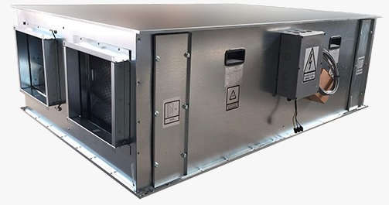
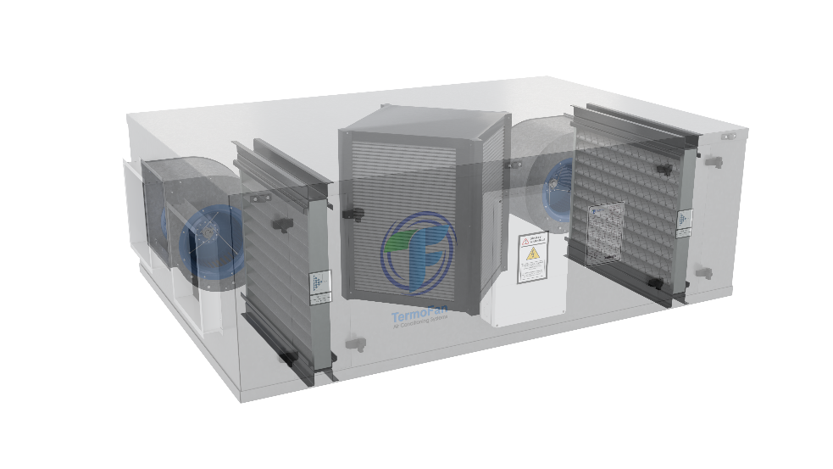
TermoFan Product
THRV
Heat Recovery Units
Klima Santrali Seçim Programı
THRV series heat recovery units body structure was designed with taking into consideration of future standarts. Especially, criteria of efficiency was created above of nowadays standarts. Energy consumptions were reduced with minimizing of energy losses in the days of increasing of importance of energy consumptions. Shape of designing of fan montage that consist of THRV series heat recovery units was avoided turbulance flow in the units.
THRV series heat recovery units are in compact structure at the same time with low air flow velocities. In this way, units catch low pressure drops and at the same time units will be at high efficiency. While heat recovery units running, if there will occur any condensation, THRV series has drain outlet standardly.
The THRV standart model units are produced in 6 basic sizes with air flow rates ranging from 500 m3/h – 5.000 m3/h.

Slide 15
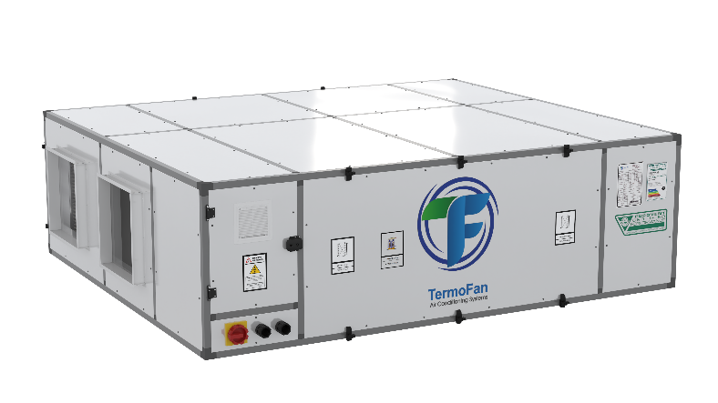
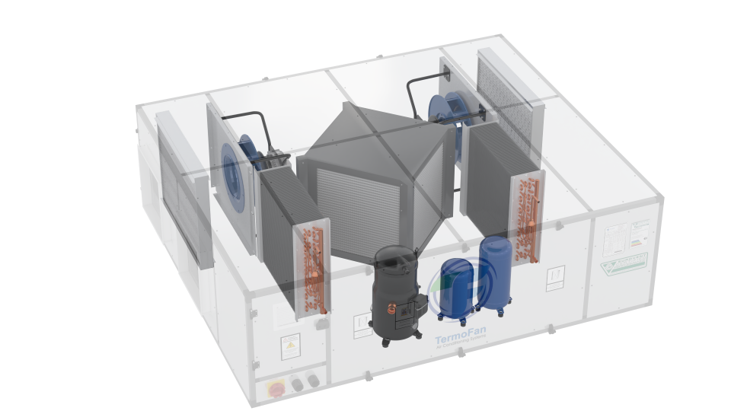
TermoFan Product
THRV-DX
DX Heat Pump Heat Recovery Units
TVHR DX heat recovery ventilation units with heat pump, designed for saving energy and also improving indoor air quality. TVHR DX units provide heat recovery and well conditioned fresh air by air to air plate type exchanger and heat pump. 30°C fresh air in the summer time and 12°C fresh air in the winter time can be obtained by usual heat recovery units, but these results are not comfortable. It can provide 20°C fresh air in the summer time and 25°C fresh air in the winter with high efficiency heat pump.
• 6 standard models,
• 50mm rockwool insulation,
• Conditioned fresh air, with a temperature of 20°C in summer and 25°C in winter.
• Compact structure (fresh air fan + exhaust air fan + plate type heat exchanger+evaporator+ condenser + compressor + cooling equipments).
• The design provide, providing fast and easy installation and maintenance,
• Low noise level and working on required capacity by using direct driven fan with 3 speeds
• The high conductivity and performance, aluminum plate type heat recovery exchanger.
The THRV standart model units are produced in 6 basic sizes with air flow rates ranging from 500 m3/h – 4.000 m3/h.
Klima Santrali Seçim Programı

Slide 16
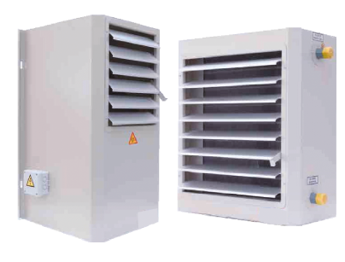
TermoFan Product
TITA,TIDA
Unit Heater
Klima Santrali Seçim Programı
These devices, which can be used in rooms that require heating in large volumes, such as, factories, plants, workshops, garages, hangars and gyms. Hot water, steam and electrical energy can be used as the heating medium in a variety of modes. TITA series units with axial fans are more suitable for use in places up to 4 m high where the devices will operate, and TIDA series units with radial fans – in volumes greater than 4 m.
TIDA version has backward curved, single inlet, direct driven radial fans.
TITA version has axial fans with inlet grill for protection.
Alternatively, it is available as a exproof, steam and cooling devices.

Slide 17
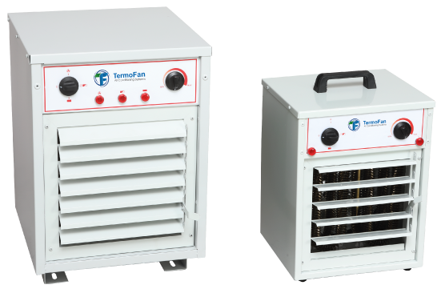
TermoFan Product
TITA-E
BX-EA Electrical Fan Heaters
Klima Santrali Seçim Programı
• Shock resistance with high resistance stainless steel • BX series, with single-speed, EA series with two-speed axial fan • BX series, floor type, EA series wall type, with two-stage electric heater • BX series with overheat protection with manual reset • BX series, with automatic thermostat • EA series, automatic thermostat with optional ambient temperature sensor • With BX-series, the possibility to use a heater and a fan together or separately • Fresh air connection option in EA series.
• In homes requiring rapid and sudden heating • In storage areas • When heating the working areas of factories • When heating locker rooms, locker rooms • When drying and heating humid environments • In protecting the vegetable warehouse from frost.

Slide 18
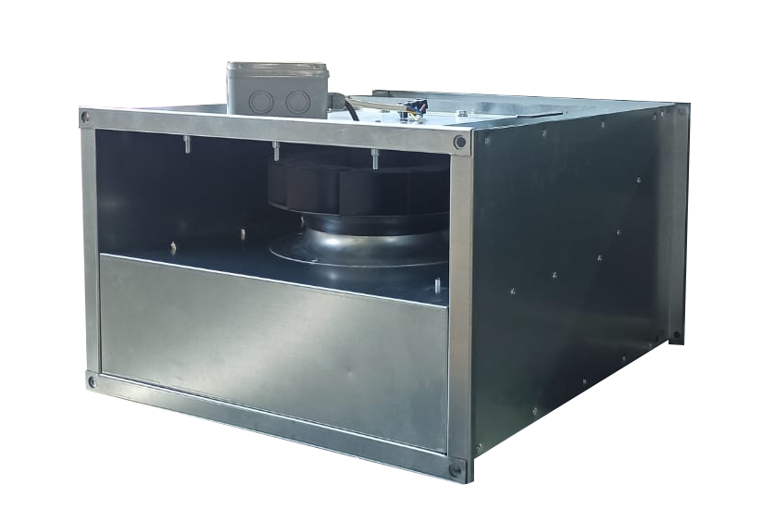
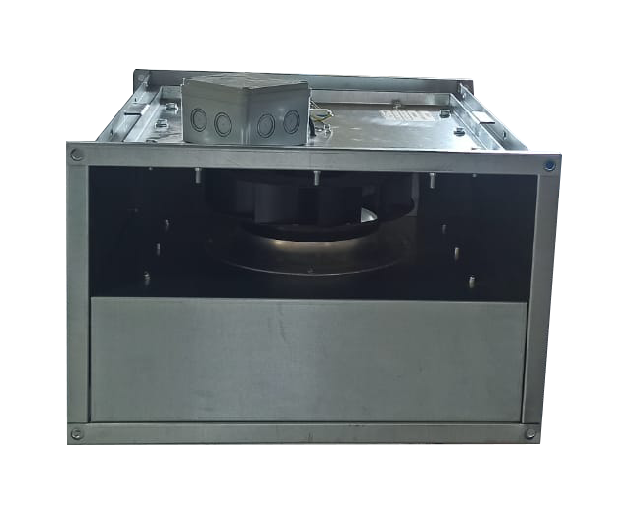
TermoFan Product
TDF
Duct Type Fans
Klima Santrali Seçim Programı
• Galvanised steel casing • Backward curved type, direct coupled and external rotor fan. • Easy instal!ation with glanged connection • Motor protection class is IP 44 and IP 67 for electrical connection box. • Accessible rotor and motor for maintenance and service • Fans can be installed at each requested angle
• Speed controllers are optional

Slide 19
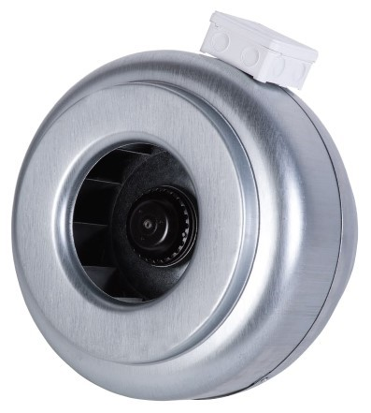
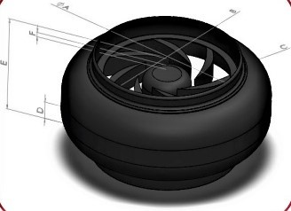
TermoFan Product
TYF
Circular Duct Fan
• The product is made of galvanized material. • It has a propeller design with radial type blades. • Resistant to corrosion. • All models operate at 230V voltage. • Speed control option is available. • Motor protection class IPX4. • Suitable for duct installation

Slide 20
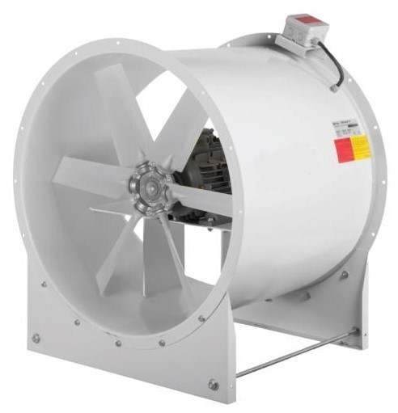
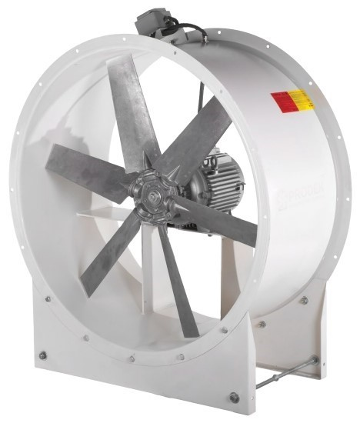
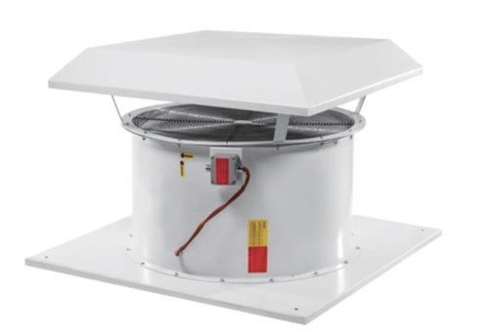
TermoFan Product
TAF
Axial Fans
• The product has an adjustable fiber reinforced polyamide propeller design. • An aluminum propeller option is available. • With electrostatic powder coating, resistant to corrosion. • All products operate at a voltage of 380 V. • Possibility to make a bidirectional and two-speed model. • Suitable for drive with frequency inverter. • Motor protection class IP55, possibility to choose with efficiency class IE1, IE2,IE3. • Design: suitable for installation in air ducts. • Operating temperature: +55C. • Has a Certificate of Fire Resistance.

Slide 21
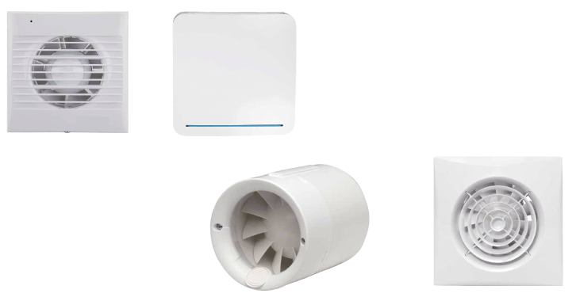
TermoFan Product
TBF
Bathroom Fans
• The product is made entirely of ABS plastic. • All products operate at 230V. • The motor has a heat protected ball bearing and has a long service life. • Motor protection class IPX4. • Usage: suitable for wall and ceiling mounting. • Low-noise design.

Slide 22
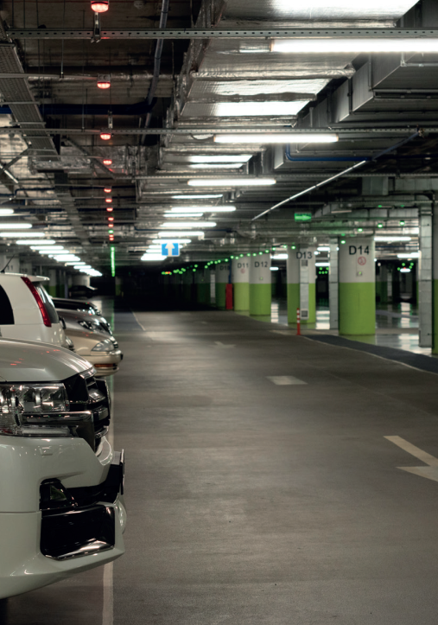
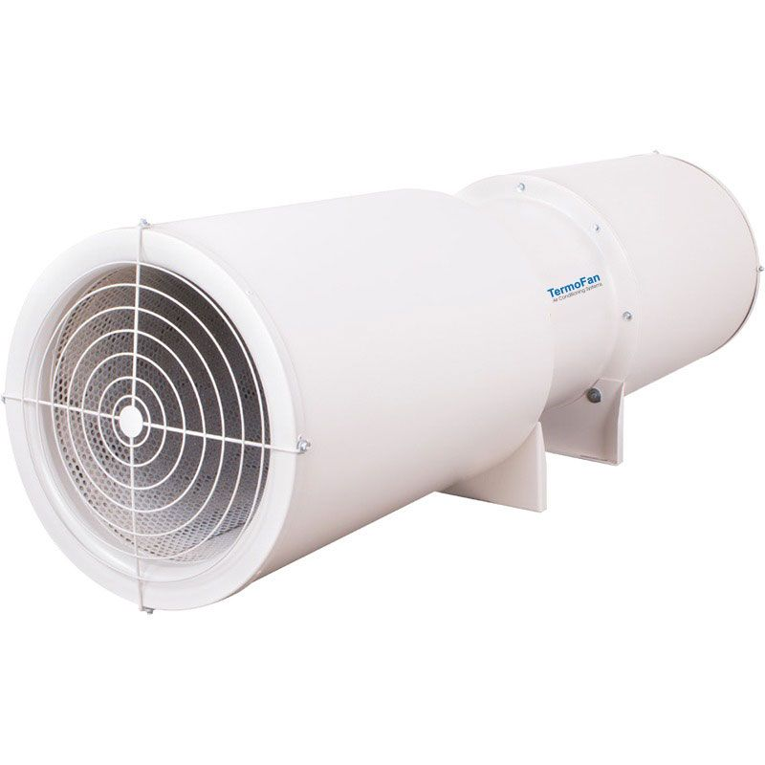
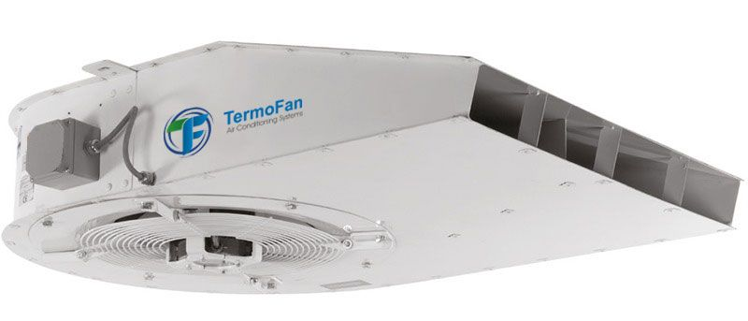
TermoFan Projects
Klima Santrali Seçim Programı
JET FAN PROJECTS
JET FAN
AXIAL JET FAN
AXIAL SMOKE EXHAUST FAN
ROOF TYPE SMOKE EXHAUST FAN
DUCT TYPE CIRCULAR RADIAL FAN

Slide 23
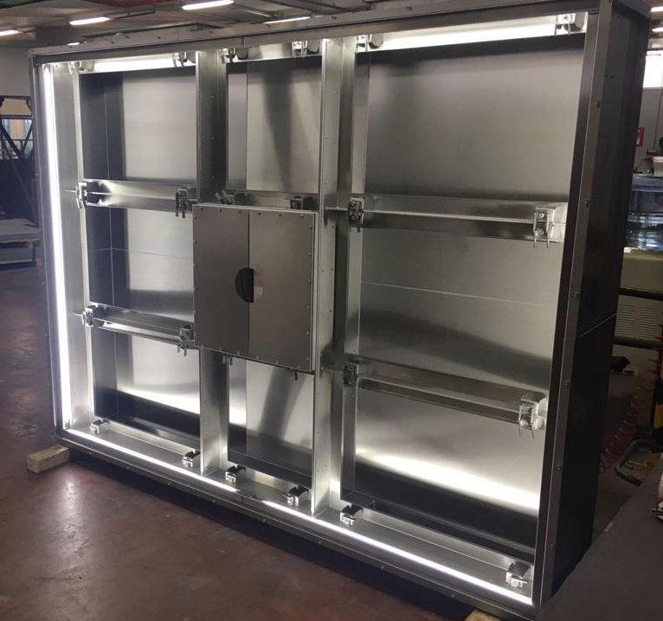
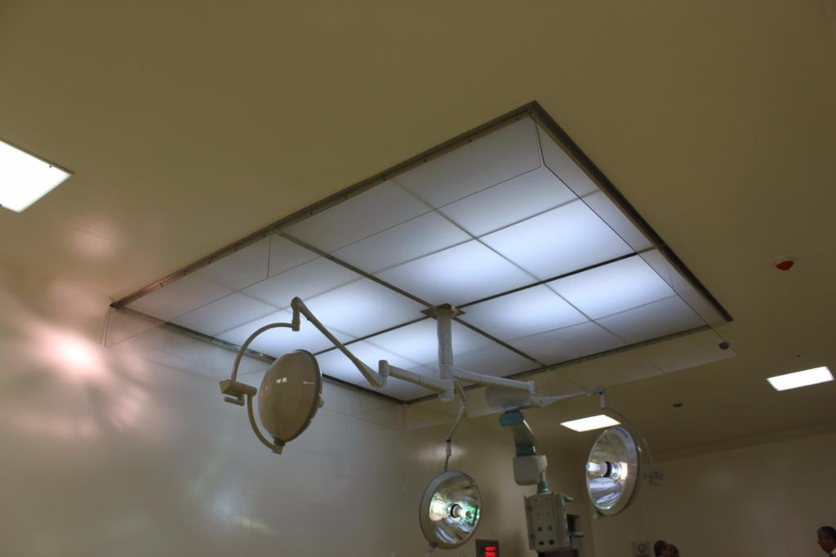
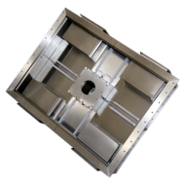
TermoFan Projects
Klima Santrali Seçim Programı
LAMINAR FLOW UNITS
USUALLY USED IN OPERATING ROOMS. PROTECTING THE PATIENT,OPERATION TEAM AND OPERATING TOOLS AROUND. THESE UNITS SWEEPS THE AIR WITH A LOW-TURBULENCE LINEAR FLOW IN ORDER TO CLEAN THE AIR FROM PARTICLES.

Slide 24
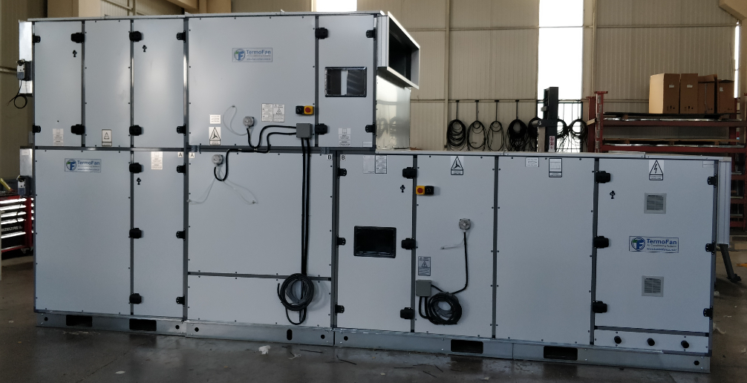
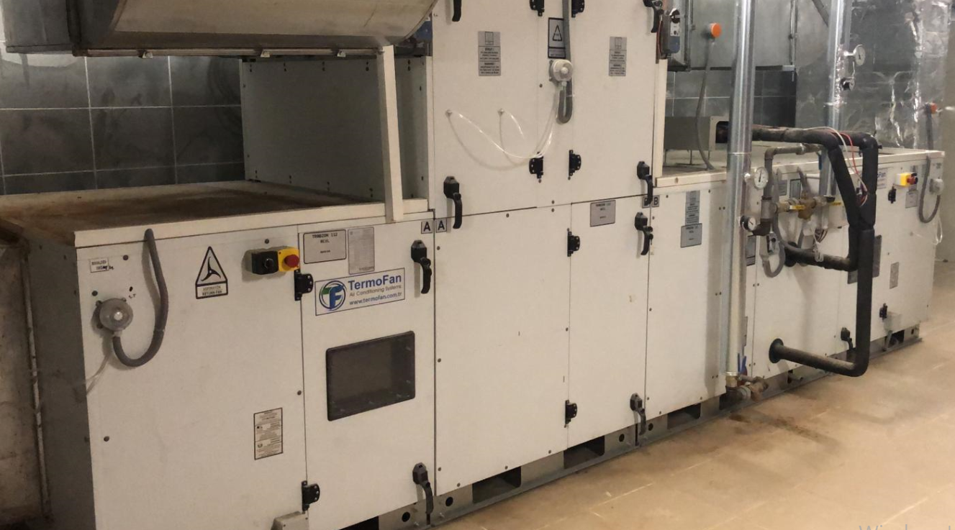
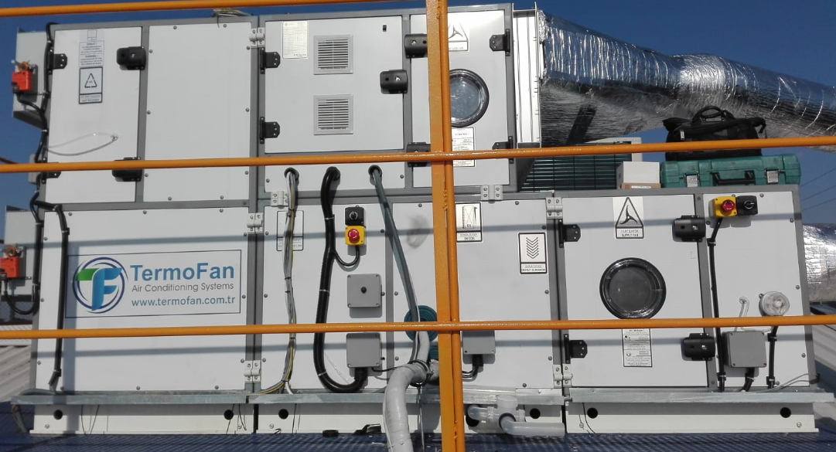
Product Photos
Klima Santrali Seçim Programı

Slide 25
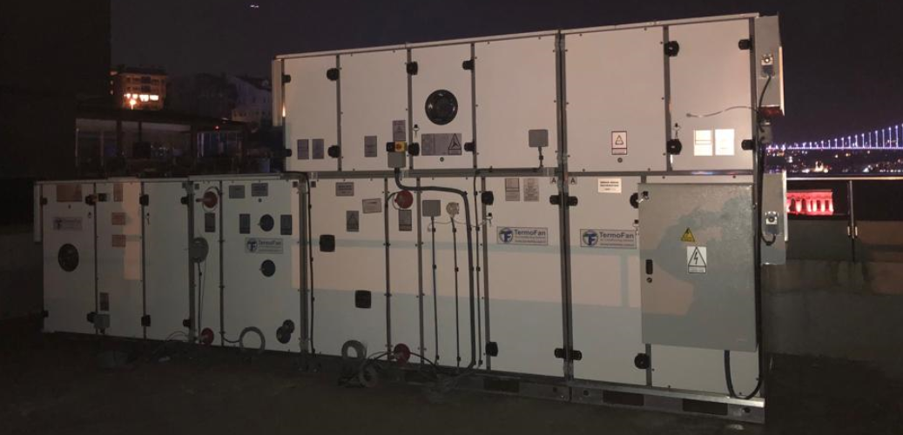
Product Photos
Klima Santrali Seçim Programı

Slide 26
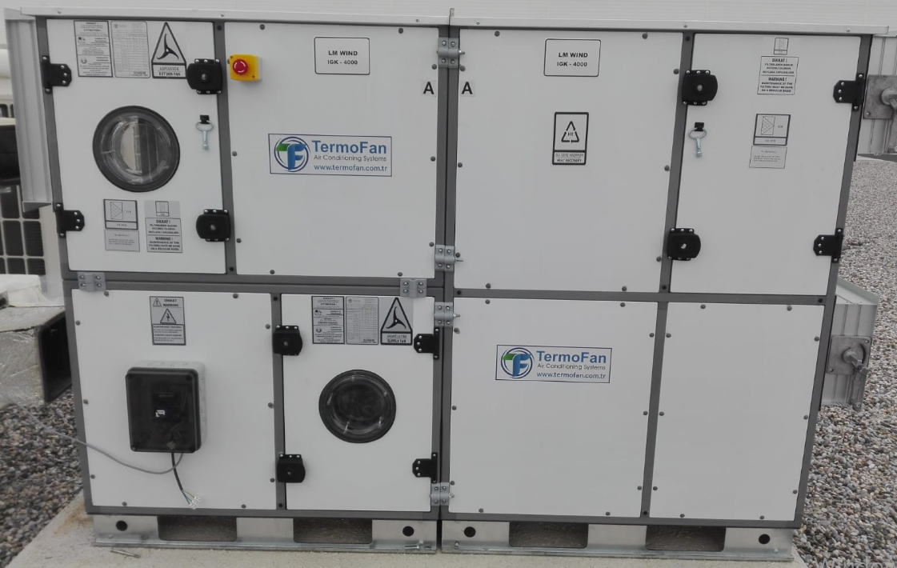
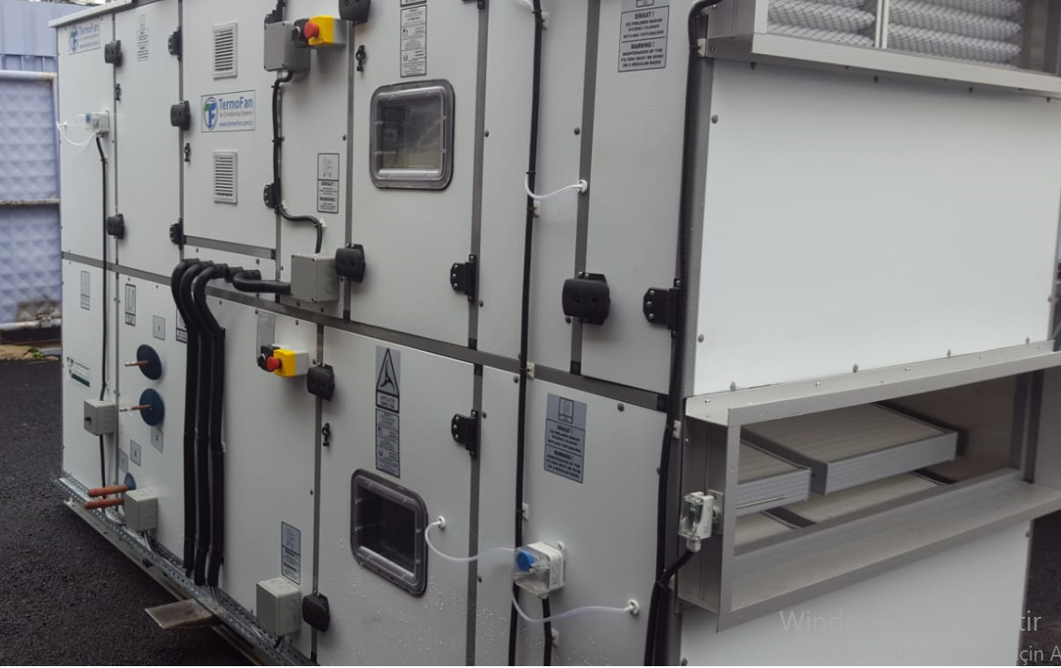
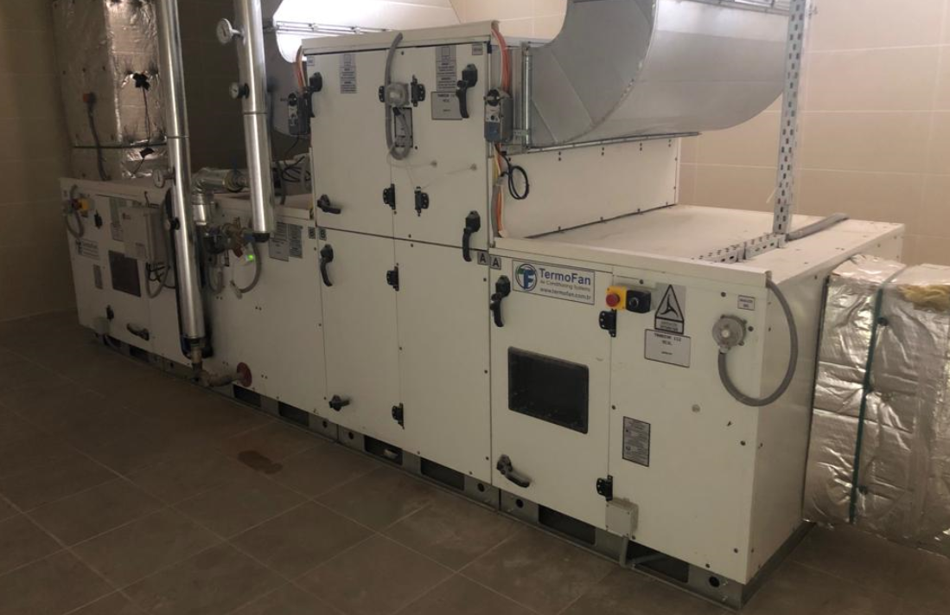
Product Photos
Klima Santrali Seçim Programı

Slide 27
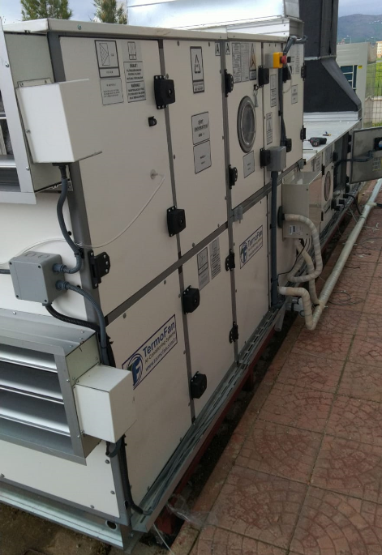
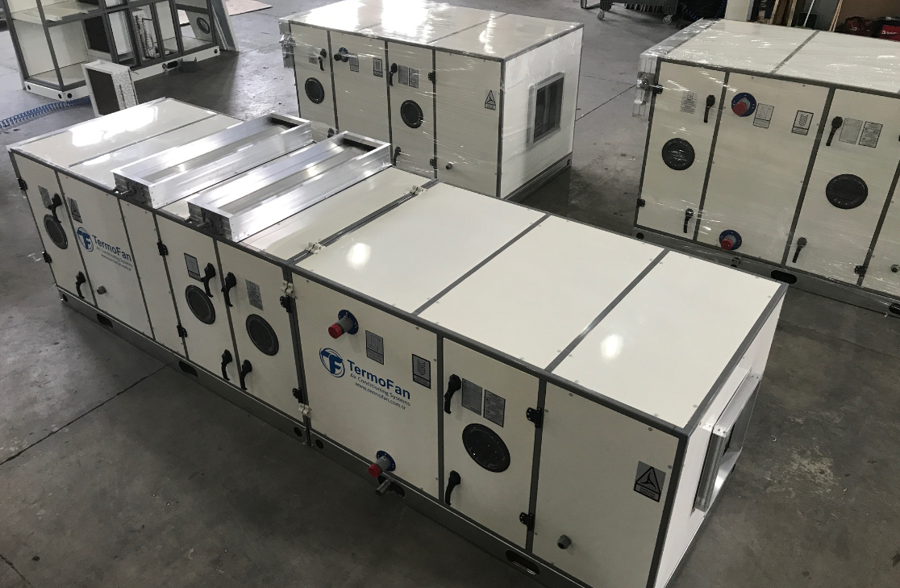
Product Photos
Klima Santrali Seçim Programı

Slide 28
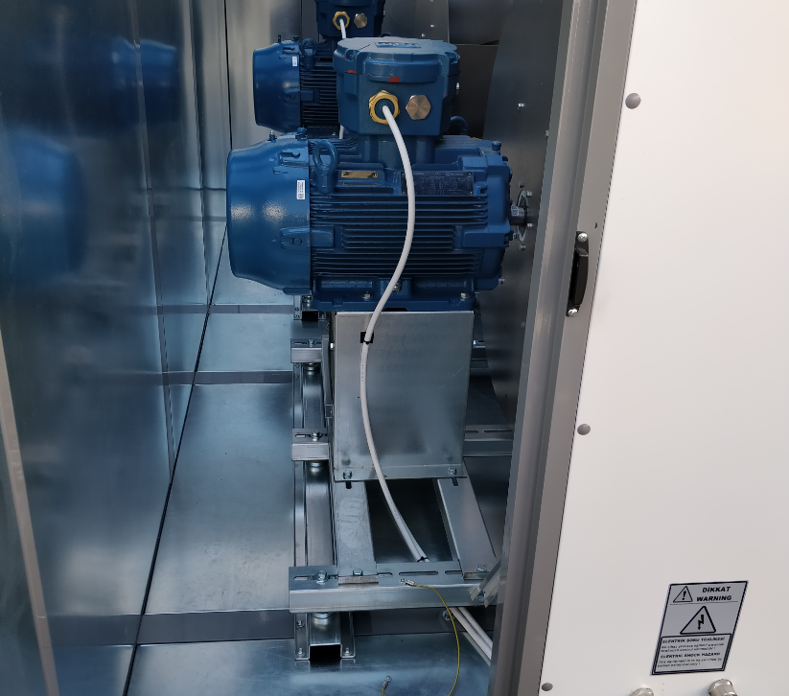
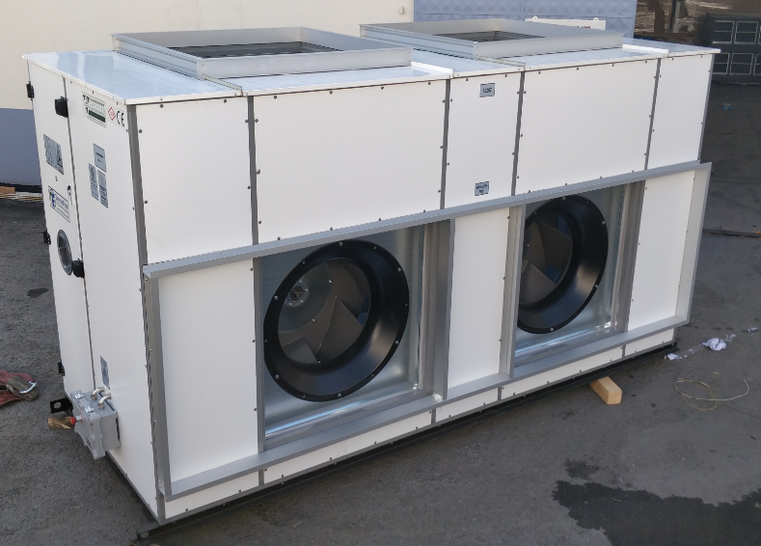

Product Photos
Klima Santrali Seçim Programı

Slide 29



Product Photos
Klima Santrali Seçim Programı

Slide 30



Product Photos
Klima Santrali Seçim Programı

Slide 31

Product Photos
Klima Santrali Seçim Programı

Slide 32



Product Photos
Klima Santrali Seçim Programı

Slide 33


Product Photos
Klima Santrali Seçim Programı

Slide 34



Product Photos
Klima Santrali Seçim Programı

Slide 35



Product Photos
Klima Santrali Seçim Programı

Slide 36



Product Photos
Klima Santrali Seçim Programı

Slide 37




Product Photos
Klima Santrali Seçim Programı

Slide 38


TermoFan Projects
Klima Santrali Seçim Programı
MAXX ROYAL BODRUM OTEL
2.500 KW – CHILLER / 3.000 KW - COOLING TOWER 112 PCS AIR HANDLIN UNITS 32PCS ECOLOGIC UNIT

Slide 39



TermoFan Projects
Klima Santrali Seçim Programı
POMEGA ENERJİ DEPOLAMA TEKNOLOJİLERİ A.Ş.
18.000 M3/H - TKS 17-13 HRU AHU + AUTOMATION PANEL
14.000 M3/H – TKS 16-13 HRU AHU + AUTOMATION PANEL
12.750 M3/H – TKS 14-13 AHU + AUTOMATION PANEL
12.000 M3/H - TKS 14-10 HRU AHU + AUTOMATION PANEL
11.300 M3/H – TKS 14-10 HRU AHU + AUTOMATION PANEL
…
49PCS AIR HANDLIN UNITS RELATIVE HUMIDITY LOWER 1%

Slide 40

TermoFan Projects
BASRA MALL
102 PCS AIR HANDLIN UNITS 44PCS ECOLOGIC UNIT

Slide 41




TermoFan Projects
Klima Santrali Seçim Programı
XIAOMI FACTORY TÜRKİYE
- 38.000 M3/H - TKS 22-22 MIXED AHU- G4+F7+F9 FILTERED
- 213 KW OUTDOOR UNIT 76HP
- 35.000 M3/H - TKS 22-19 MIXED AHU- G4+F7+F9 FILTERED
- 198 KW OUTDOOR UNIT 70HP
- 20.700 M3/H - TKS 19-14 MIXED AHU- G4+F7+F9 FILTERED
- 97 KW OUTDOOR UNIT
- 19.100 M3/H - TKS 19-14 MIXED AHU- G4+F7+F9 FILTERED
- 85 KW OUTDOOR UNIT
- 18.100 M3/H - TKS 17-14 MIXED AHU- G4+F7+F9 FILTERED
- 75 KW OUTDOOR UNIT
- 18.000 M3/H - TKS 17-14 MIXED AHU- G4+F7+F9 FILTERED
- 75 KW OUTDOOR UNIT
- 18.000 M3/H - TKS 17-14 MIXED AHU- G4+F7+F9 FILTERED
- 89 KW OUTDOOR UNIT
- 17.000 M3/H - TKS 17-14 MIXED AHU- G4+F7+F9 FILTERED
- 93 KW OUTDOOR UNIT
- 17.700 M3/H - TKS 14-14
- 17.000 M3/H - TKS 17-14 MIXED AHU- G4+F7+F9 FILTERED
- 93 KW OUTDOOR UNIT
- 3.000 M3/H - TKS 9-7 MIXED AHU- G4+F7+F9 FILTERED
- 14 KW OUTDOOR UNIT
- 3.000 M3/H - TKS 9-7 MIXED AHU- G4+F7+F9 FILTERED
- 15 KW OUTDOOR UNIT
- ROOF TOP
- 10.000 M3/H - TKS 13-10 BOX FAN
- 3 KW FREQUENCE INVERTOR

Slide 42



TermoFan Projects
Klima Santrali Seçim Programı
Nordex Energy Mexico
4PCS 1000KW CHILLER
29PCS AIR HANDLING UNITS

Slide 43



TermoFan Projects
Klima Santrali Seçim Programı
Bitron Elektromekanik Ltd. Şti.
40.000 M3/H TKS 22-19 KS MIXED AHU + 22 KW FREQUENCY INVERTER
- 24.000 M3/H TKS 19-16 KS MIXED AHU + 15 KW FREQUENCY INVERTER
- 20.000 M3/H TKS 19-14 KS MIXED AHU + 11 KW FREQUENCY INVERTER
- 10.000 M3/H TKS 14-10 KS MIXED AHU + 5,5 KW FREQUENCY INVERTER
- 9.000 M3/H TKS 13-10 KS MIXED AHU + 5,5 KW FREQUENCY INVERTER
- 8.000 M3/H TKS 13-9 KS + 15 KW FREQUENCY INVERTER
- 5.000 M3/H THRV-50 HEAT RECOVERY UNIT
- 1.000 M3/H THRV-10 HEAT RECOVERY UNIT
- 850 M3/H THRV-10 HEAT RECOVERY UNIT
- 750 M3/H THRV-10 HEAT RECOVERY UNIT
- DUCT TYPE CIRCULAR FAN

Slide 44



TermoFan Projects
Klima Santrali Seçim Programı
METRO ISTANBUL / ULAŞIM A.Ş. PROJECTS
- AIR HANDLING UNIT
- EXHAUST FAN
- HEAT RECOVERY UNIT
INLINE RECTANGLE FAN

Slide 45


TermoFan Projects
50.400 M3/H TKS 22-19 MIXED HRU AHU
45.000 M3/H TKS 22-19 AHU
45.000 M3/H TKS 22-19 AHU
32.000 M3/H TKS 22-17 MIXED AHU
32.000 M3/H TKS 22-17 MIXED AHU
- 32.000 M3/H TKS 22-17 AHU
- 11.900 M3/H TKS 14-13 MIXED AHU
- 10.950 M3/H TKS 14-10 AHU
- 9.200 M3/H TKS 13-9 MIXED AHU
8.700 M3/H TKS 13-9 MIXED AHU
7.600 M3/H TKS 14-13 AHU
6.100 M3/H TKS 9-9 MIXED AHU
- 6.000 M3/H TKS 9-9 MIXED AHU
5.500 M3/H TKS 10-9 MIXED HRU AHU
- 5.400 M3/H TKS 9-9 MIXED AHU
5.250 M3/H TKS 9-9 MIXED AHU
3.000 M3/H TKS 9-7 MIXED AHU
Klima Santrali Seçim Programı
POLİBAK- BOPP ÜRETİM ALANLARI PROJECTS

Slide 46




TermoFan Projects
Klima Santrali Seçim Programı
DEPO MALL
- 26.400 M3/H ROOF TOP
- 20.600 M3/H ROOF TOP
- 12.600 M3/H ROOF TOP
13.950 M3/H TKS 14-14 AHU + AUTOMATION PANEL
- 11.250 M3/H TKS 13-13 AHU + AUTOMATION PANEL
- 11.500 M3/H TKS 13-13 AHU + AUTOMATION PANEL
- 10.800 M3/H TKS 13-13 AHU + AUTOMATION PANEL
- 10.200 M3/H TKS 13-13 AHU + AUTOMATION PANEL
- 10.050 M3/H TKS 14-10 AHU + AUTOMATION PANEL
- 9.940 M3/H TKS 14-10 AHU + AUTOMATION PANEL
- 8.950 M3/H TKS 14-10 AHU + AUTOMATION PANEL
- 7.500 M3/H TKS 13-9 AHU + AUTOMATION PANEL
- 7.000 M3/H TKS 13-9 AHU + AUTOMATION PANEL
- 4.800 M3/H TKS 10-9 AHU + AUTOMATION PANEL

Slide 47





TermoFan Projects
Klima Santrali Seçim Programı
İSDEMİR
İSKENDERUN FACTORY OFFICE
57.785 M3/H TKS 22-19 HRU AHU + AUTOMATION PANEL
55.725 M3/H TKS 22-19 HRU AHU + AUTOMATION PANEL
43.300 M3/H TKS 22-19 HRU AHU + AUTOMATION PANEL
21.180 M3/H TKS 22-16 HRU AHU + AUTOMATION PANEL
11.500 M3/H TKS 14-13 HRU AHU + AUTOMATION PANEL
AIR COOLED PACKAGE UNIT
LAMINAR FLOW UNIT
FANCOIL

Slide 48



TermoFan Projeсt
Klima Santrali Seçim Programı
CHINESE WIND FABRİKASI
- 50.000 M3/H TKS 22-22 AHU + AUTOMATION PANEL
- 50.000 M3/H TKS 22-22 AHU +-AUTOMATION PANEL
- 50.000 M3/H TKS 22-22 AHU + -AUTOMATION PANEL
- 50.000 M3/H TKS 22-22 AHU + AUTOMATION PANEL
- 50.000 M3/H TKS 22-22 AHU + AUTOMATION PANEL
- 50.000 M3/H TKS 22-22 AHU + AUTOMATION PANEL
- 50.000 M3/H TKS 22-22 AHU + AUTOMATION PANEL
- 30.000 M3/H TKS 22-17 AHU + AUTOMATION PANEL
- 30.000 M3/H TKS 22-17 AHU + AUTOMATION PANEL
- 30.000 M3/H TKS 22-17 AHU + AUTOMATION PANEL
- 30.000 M3/H TKS 22-17 AHU + AUTOMATION PANEL
- 30.000 M3/H TKS 22-17 AHU + AUTOMATION PANEL
- 18.000 M3/H TKS 17-14 %30 FRESH AIR AHU + AUTOMATION PANEL
- 9.000 M3/H TKS 14-10 HRU AHU + AUTOMATION PANEL
- FREQUENCE INVERTOR

Slide 49



TermoFan Projeсt
Klima Santrali Seçim Programı
JAPANESE TOBACCO FACTORY
ZJIANJAN IRAN
- 83.500 M3/H TKS 22-22 AHU + AUTOMATION PANEL
- 83.500 M3/H TKS 22-22 AHU + AUTOMATION PANEL
- 83.500 M3/H TKS 22-22 AHU + AUTOMATION PANEL
- 36.450 M3/H TKS 22-10 AHU + -AUTOMATION PANEL
- EC FAN

Slide 50




TermoFan Projeсt
Klima Santrali Seçim Programı
LM WIND POWER TÜRKIYE
65.000 M3/H TKS 22-19 HRU AHU + AUTOMATION PANEL
65.000 M3/H TKS 22-19 HRU AHU + AUTOMATION PANEL
45.000 M3/H TKS 22-17 HRU AHU + AUTOMATION PANEL
45.000 M3/H TKS 22-17 HRU AHU + AUTOMATION PANEL
45.000 M3/H TKS 22-17 HRU AHU + AUTOMATION PANEL
- 6.000 M3/H TKS 10-9 HRU AHU + AUTOMATION PANEL
- 4.000 M3/H HEAT RECOVERY UNIT

Slide 51





TermoFan Projeсt
50.000 M3/H TKS22-22 AHU + AUTOMATION PANEL
7.500 M3/H TKS13-9 AHU + AUTOMATION PANEL
18.000 M3/H WATER COOLED PACKAGE TYPE AHU + AUTOMATION PANEL
18.000 M3/H WATER COOLED PACKAGE TYPE AHU + AUTOMATION PANEL
M3/H M3/H HAVA SOĞUTMALİ PACKAGE TYPE AHU + AUTOMATION PANEL
36.000 M3/H TKS19-14 BOX FAN
3 KW FREQUENCE INVERTOR
36.000 M3/H TKS19-14 BOX FAN
4 KW FREQUENCE INVERTOR
36.000 M3/H TKS19-14BOX VENTILATOR
36.000 M3/H HEAT RECOVERY CELL WITH PLATE
9.800 M3/H TKS10-9 BOX FAN (G4 FILTER)
- 5.000 M3/H TKS10-9 BOX FAN (METAL FILTER)
- 4.000 M3/H TKS10-10 BOX FAN (METAL FILTER)
Klima Santrali Seçim Programı
SUMITOMO FACTORY

Slide 52



TermoFan Projects
20.070 M3/H TKS19-19 AHU + AUTOMATION PANEL
14.180 M3/H TKS19-19 AHU + AUTOMATION PANEL
11.090 M3/H TKS19-19 AHU + AUTOMATION PANEL
11.000 M3/H TKS19-19 AHU + AUTOMATION PANEL
10.440 M3/H TKS19-19 AHU + AUTOMATION PANEL
8.280 M3/H TKS19-19 AHU + AUTOMATION PANEL
11.760 M3/H TKS14-13 HRU AHU + AUTOMATION PANEL
11.400 M3/H TKS14-10 HRU AHU + AUTOMATION PANEL
9.900 M3/H TKS14-10 HRU AHU + AUTOMATION PANEL
9.840 M3/H TKS14-10 HRU AHU + AUTOMATION PANEL
9.720 M3/H TKS14-10 HRU AHU + AUTOMATION PANEL
6.900 M3/H TKS13-9 HRU AHU + AUTOMATION PANEL
5.520 M3/H TKS13-9 HRU AHU + AUTOMATION PANEL
4.980 M3/H TKS14-10 HRU AHU + AUTOMATION PANEL
4.680 M3/H TKS10-9 HRU AHU + AUTOMATION PANEL
9.900 M3/H TKS13-10 BOX FAN (METAL FILTER)
2.500 M3/H THRV-50 HEAT RECOVERY UNIT
Klima Santrali Seçim Programı
VESTEL FABRİKA PROJECTS

Slide 53







TermoFan Projects
Klima Santrali Seçim Programı
SIEGWERK FABRİKA PROJECTS
98.500 M3/H TKS22-22 AHU + 18,5 KW FREQUENCE INVERTOR
AUTOMATION PANEL
4.500 M3/H TKS9-7 HRU AHU + AUTOMATION PANEL
OUTDOOR UNIT
100.000 M3/H TKS 22-22 BOX FAN
11 KW FREQUENCE INVERTOR
70.000 M3/H TKS 22-22 BOX FAN
11 KW FREQUENCE INVERTOR
60.000 M3/H TKS 22-22 BOX FAN
15 KW FREQUENCE INVERTOR
5.20 m
2.70 m

Slide 54




TermoFan Projects
Klima Santrali Seçim Programı
GOOD YEAR ADAPAZARI
30.000 M3/H TKS22-17 AHU + AUTOMATION PANEL
20.000 M3/H ROOF TOP MOTORIZED DAMPER
16.000 M3/H TKS13-10 AHU + AUTOMATION PANEL
15.000 M3/H TKS16-13 AHU + AUTOMATION PANEL
8.000 M3/H TKS16-14 AHU + AUTOMATION PANEL
15 KW FREQUENCE INVERTOR
AIR CLEANING DEVICE WITH HYGIENE REACTOR

Slide 55




TermoFan Projects
Klima Santrali Seçim Programı
SUDANESE GARRİ POWER PLANT
63.000 M3/H TKS22-22 AHU + AUTOMATION PANEL
63.000 M3/H TKS22-22 AHU + AUTOMATION PANEL
63.000 M3/H TKS22-22 AHU + AUTOMATION PANEL
63.000 M3/H TKS22-22 AHU + AUTOMATION PANEL

Slide 56










TermoFan Projects
Klima Santrali Seçim Programı
YARN ANATOLİA FACTROY
150.000 M3/H TKS22-22 MIXED AHU
AUTOMATION PANEL

Slide 57


26.400 M3/H TKS22-19 AHU + AUTOMATION PANEL
25.500 M3/H TKS22-19 AHU + AUTOMATION PANEL
18.000 M3/H TKS17-16 AHU MIXED AIR+
AUTOMATION PANEL
18.000 M3/H TKS17-16 AHU MIXED AIR+
AUTOMATION PANEL
18.000 M3/H TKS17-16 AHU MIXED AIR+
AUTOMATION PANEL
12.500 M3/H TKS16-13 AHU + AUTOMATION PANEL
11.500 M3/H TKS16-13 AHU + AUTOMATION PANEL
10.000 M3/H TKS13-13 AHU + AUTOMATION PANEL
8.750 M3/H TKS13-13 AHU + AUTOMATION PANEL
6.250 M3/H TKS13-9 AHU + AUTOMATION PANEL
4.500 M3/H TKS10-9 AHU + AUTOMATION PANEL
3.000 M3/H THRV-30 HEAT RECOVERY UNIT
3.000 M3/H THRV-30 HEAT RECOVERY UNIT
1.500 M3/H THRV-15 HEAT RECOVERY UNIT
1.500 M3/H THRV-15 HEAT RECOVERY UNIT
1.500 M3/H THRV-15 HEAT RECOVERY UNIT
TermoFan Projects
Klima Santrali Seçim Programı
VOYAGE HOTEL

Slide 58



TermoFan Projects
Klima Santrali Seçim Programı
11.000 M3/H TKS14-10 AHU + AUTOMATION PANEL
3 KW FREQUENCE INVERTOR
11.000 M3/H TKS14-10 AHU + AUTOMATION PANEL
14.500 M3/H ТКС 13-13 BOX FAN
5,5 KW FREQUENCE INVERTOR
5.000 M3/H ТКС 9-7 BOX FAN
HILTON OTEL PROJECTS

Slide 59



TermoFan Projects
17.700 M3/H TKS19-14 AHU
11 KW FREQUENCE INVERTOR
14.700 M3/H TKS17-13 HRU AHU
11 KW FREQUENCE INVERTOR
9.000 M3/H TKS14-10 HRU AHU
7,5 KW FREQUENCE INVERTOR
3.660 M3/H TKS14-10 HRU AHU
1,5 KW FREQUENCE INVERTOR
10.450 M3/H ТКС 9-7 BOX FAN
6.530 M3/H ТКС 9-7 BOX FAN
Klima Santrali Seçim Programı
RAMADA BY WYNDHAM HOTEL
TBLISI

Slide 60


9.709 M3/H TKS13-13 AHU MIXED AIR+
AUTOMATION PANEL
8.640 M3/H TKS14-10 HRU AHU
AUTOMATION PANEL + FREQUENCE INVERTOR
4.680 M3/H TKS13-9 HRU AHU
AUTOMATION PANEL+ FREQUENCE INVERTOR
4.680 M3/H TKS13-9 HRU AHU
AUTOMATION PANEL+ FREQUENCE INVERTOR
10.000 M3/H ТКС13-10 BOX FAN
3 KW FREQUENCE INVERTOR
5.000 M3/H ТКС10-9 BOX FAN
1,5 KW FREQUENCE INVERTOR
4.000 M3/H ТКС9-9 BOX FAN
1,5 KW FREQUENCE INVERTOR
4.000 M3/H ТКС9-9 BOX FAN
1,5 KW FREQUENCE INVERTOR
4.000 M3/H ТКС9-9 BOX FAN
1,5 KW FREQUENCE INVERTOR
3.200 M3/H ТКС9-7 BOX FAN
0,75 KW FREQUENCE INVERTOR
3.200 M3/H ТКС9-7 BOX FAN
0,75 KW FREQUENCE INVERTOR
TermoFan Projects
Klima Santrali Seçim Programı
SHERATON HOTEL

Slide 61



TermoFan Projects
Klima Santrali Seçim Programı
16.200 M3/H TKS17-16 AHU MIXED AIR+
AUTOMATION PANEL
15.500 M3/H TKS16-14 AHU + AUTOMATION PANEL
10.500 M3/H TKS13-13 AHU MIXED AIR+
AUTOMATION PANEL
10.500 M3/H TKS13-13 AHU + AUTOMATION PANEL
10.000 M3/H TKS13-13 AHU + AUTOMATION PANEL
9.250 M3/H TKS13-10 AHU MIXED AIR+
AUTOMATION PANEL
8.600 M3/H TKS13-10 AHU MIXED AIR+
AUTOMATION PANEL
7.500 M3/H TKS13-9 AHU MIXED AIR+
AUTOMATION PANEL
4.000 M3/H THNS 6000 THNS 14300 PACKAGE TYPE POOL DEHUMIDIFICATION UNIT
2.000 M3/H THRV-20 HEAT RECOVERY UNIT
RADISSON BLU HOTEL

Slide 62




TermoFan Projects
Klima Santrali Seçim Programı
RIXOS OTEL PROJECTS
Rixos Premium DUBAI
Rixos Premium BODRUM
Rixos Premium DUBROVNIK
Rixos Premium ABU DHABI
13.500 M3/H TKS16-13 AHU + AUTOMATION PANEL
10.000 M3/H TKS13-13 AHU + AUTOMATION PANEL
8.000 M3/H TKS13-10 AHU + AUTOMATION PANEL
6.000 M3/H TKS10-10 BOX FAN
4.320 M3/H TKS9-7 BOX FAN
3.900 M3/H TKS9-7 BOX FAN
3.600 M3/H TKS9-7 BOX FAN
3.000 M3/H TKS7-7 BOX FAN
1.500 M3/H TKS7-7 BOX FAN
3.000 M3/H THRV-40 HEAT RECOVERY UNIT

Slide 63


TermoFan Projects
Klima Santrali Seçim Programı
13.500 M3/H TKS16-13 AHU + AUTOMATION PANEL
10.000 M3/H TKS13-13 AHU + AUTOMATION PANEL
8.000 M3/H TKS13-10 AHU + AUTOMATION PANEL
6.000 M3/H TKS10-10 BOX FAN
4.320 M3/H TKS9-7 BOX FAN
3.900 M3/H TKS9-7 BOX FAN
3.600 M3/H TKS9-7 BOX FAN
3.000 M3/H TKS7-7 BOX FAN
1.500 M3/H TKS7-7 BOX FAN
3.000 M3/H THRV-40 HEAT RECOVERY UNIT
TEKNOPARK / İSTANBUL

Slide 64



TermoFan Projects
Klima Santrali Seçim Programı
80.000 M3/H TKS22-22 AHU HUMIDIFIER MODULE +
AUTOMATION PANEL
43.000 M3/H TKS22-22 AHU HUMIDIFIER MODULE+
AUTOMATION PANEL
25.000 M3/H TKS19-17 AHU HUMIDIFIER MODULE+
AUTOMATION PANEL
15.000 M3/H TKS13-13 BOX FAN
7.500 M3/H TKS10-10 BOX FAN
1.500 M3/H TKS7-7 BOX FAN
26.700 M3/H ROOF TYPE AXIAL FAN
14.400 M3/H ROOF TYPE AXIAL FAN
«UZAUTO MOTORS»
KHOREZM / UZBEKSTAN

Slide 65

TermoFan Projects
Klima Santrali Seçim Programı
25.000 M3/H AHU-2 AHU FRESH AIR UNIT
20.000 M3/H AHU-3 AHU FRESH AIR UNIT
18.000 M3/H AHU-4 AHU FRESH AIR UNIT
15.000 M3/H AHU-6 AHU FRESH AIR UNIT
14.000 M3/H AHU-5 AHU FRESH AIR UNIT
13.500 M3/H AHU-1 AHU FRESH AIR UNIT
6.000 M3/H TKS9-7 BOX FAN
4.500 M3/H TKS7-7 BOX FAN
3.000 M3/H TKS7-7 BOX FAN
AUTOMATION PANEL
«YOUTH CENTER»
by GENERAL MOTOR

Slide 66


TermoFan Projects
34.002 M3/H TKS22-22 AHU + AUTOMATION PANEL
28.649 M3/H TKS22-16 AHU + AUTOMATION PANEL
25.200 M3/H TKS19-17 AHU + AUTOMATION PANEL
25.200 M3/H TKS19-17 AHU + AUTOMATION PANEL
12.960 M3/H TKS19-17 AHU + AUTOMATION PANEL
2.700 M3/H TKS19-17 AHU + AUTOMATION PANEL
28.000 M3/H TKS16-16 BOX FAN
20.200 M3/H TKS14-14 BOX FAN
15.000 M3/H TKS14-13 BOX FAN
7.000 M3/H TKS13-9 BOX FAN
6.500 M3/H TKS10-10 BOX FAN
6.000 M3/H TKS10-9 BOX FAN
3.000 M3/H TKS9-7 BOX FAN
Klima Santrali Seçim Programı
“UZBEKSTAN GTL”

Slide 67


TermoFan Projects
Klima Santrali Seçim Programı
2.000 M3/H TDF600X300 V1 RECTANGULAR DUCT TYPE FANS
2.000 M3/H TDF600X300 V1 RECTANGULAR DUCT TYPE FANS
2.000 M3/H TDF600X300 V1 RECTANGULAR DUCT TYPE FANS
2.000 M3/H TDF600X300 V1 RECTANGULAR DUCT TYPE FANS
1.400 M3/H TDF600X300 V1 RECTANGULAR DUCT TYPE FANS
7.500 M3/H RECTANGULAR DUCT TYPE FANS
1.500 M3/H TKS7-7 BOX FAN
26.700 M3/H ROOF MOUNTED AXIAL FAN
14.400 M3/H ROOF MOUNTED AXIAL FAN
TASHKENT INDEX

Slide 68


TermoFan Projects
Klima Santrali Seçim Programı
«SEOUL MUN»
AMUSEMENT PARK
49.000 M3/H ТКС22-22BOX FAN G-4 FILTERED/ CENTRIFUGAL FAN
38.500 M3/H ТКС22-22BOX FAN G-4 FILTERED / CENTRIFUGAL FAN
24.500 M3/H ТКС22-22BOX FAN G-4 FILTERED / CENTRIFUGAL FAN
26.000 M3/H DUCT TYPE AXIAL SMOKE EXHAUST FAN
2.100 M3/H TDF DUCT TYPE RECTANGULAR FAN

Slide 69


TermoFan Projects
39.000 M3/H ТКС22-19 HRU AHU + AUTOMATION PANEL
27.000 M3/H ТКС22-16 HRU AHU + AUTOMATION PANEL
26.000 M3/H ТКС19-17 HRU AHU + AUTOMATION PANEL
23.000 M3/H ТКС19-16 HRU AHU + AUTOMATION PANEL
20.000 M3/H ТКС19-14 HRU AHU + AUTOMATION PANEL
20.000 M3/H ТКС19-14 HRU AHU + AUTOMATION PANEL
12.000 M3/H ТКС19-13 HRU AHU + AUTOMATION PANEL
2.860 M3/H ТКС9-7 HRU AHU + AUTOMATION PANEL
Klima Santrali Seçim Programı
PARLIAMENT BUILDING

Slide 70


TermoFan Projects
Klima Santrali Seçim Programı
IT PARK ТАSHКЕNТ
VENTILATION SYSTEM
BOX FANS
DUCT TYPE AXIAL FANS
AXIAL SMOKE EXHAUST FAN
EXPROOF FANS
HEATINF APPARATUS
DAMPERS
FIRE DAMPERLERS

Slide 71


21.780 M3/H TKS17-17 AHU + AUTOMATION PANEL
10.000 M3/H TKS14-10 AHU + AUTOMATION PANEL
8.200 M3/H TKS13-10 AHU + AUTOMATION PANEL
6.300 M3/H TKS10-9 BOX FAN
2.200 M3/H TKS10-9 BOX FAN
3.570 M3/H THRV-40 DX HEAT RECOVERY UNIT
HEAT PUMP
3.350 M3/H THRV-40 DX HEAT RECOVERY UNIT
HEAT PUMP
3.100 M3/H THRV-40 DX HEAT RECOVERY UNIT
HEAT PUMP
2.600 M3/H THRV-30 DX HEAT RECOVERY UNIT
HEAT PUMP
2.470 M3/H THRV-30 DX HEAT RECOVERY UNIT
HEAT PUMP
TermoFan Projects
Klima Santrali Seçim Programı
TURAN BANK ТАSHKENT

Slide 72

TermoFan Projeсt
Klima Santrali Seçim Programı
TAŞKENT TIP AKADEMİSİ
20.000 M3/H ROOF TYPE SMOKE EXHAUST FAN
20.000 M3/H ROOF TYPE SMOKE EXHAUST FAN
20.000 M3/H ROOF TYPE SMOKE EXHAUST FAN
20.000 M3/H ROOF TYPE SMOKE EXHAUST FAN
4.800 M3/H TDF800*500 RECTANGULAR DUCT TYPE FANS
1.200 M3/H TDF500*300 RECTANGULAR DUCT TYPE FANS

Slide 73



10.120 M3/H TKS14-10 AHU + AUTOMATION PANEL
9.550 M3/H TKS14-10 AHU + AUTOMATION PANEL
9.150 M3/H TKS14-10 AHU + AUTOMATION PANEL
8.880 M3/H TKS13-10 AHU + AUTOMATION PANEL
8.850 M3/H TKS13-10 AHU + AUTOMATION PANEL
8.250 M3/H TKS13-10 AHU + AUTOMATION PANEL
8.000 M3/H TKS13-10 AHU + AUTOMATION PANEL
7.600 M3/H TKS13-10 AHU + AUTOMATION PANEL
6.650 M3/H TKS13-9 AHU + AUTOMATION PANEL
6.200 M3/H TKS13-9 AHU + AUTOMATION PANEL
5.850 M3/H TKS13-9 AHU + AUTOMATION PANEL
5.000 M3/H TKS10-9 AHU + AUTOMATION PANEL
4.730 M3/H TKS10-9 AHU + AUTOMATION PANEL
9.000 M3/H TKS13-10 BOX FAN
6.000 M3/H TKS10-9 BOX FAN
TermoFan Projeсt
Klima Santrali Seçim Programı
HAMPTON OTEL
CİZZAKH/ÖZBEKİSTAN

Slide 74


TermoFan Projects
Klima Santrali Seçim Programı
SIYOMA MALL
DUSHANBE / TAJKSTAN
23.400 M3/H ROOF TYPE SMOKE EXHAUST FAN
3.750 M3/H TKS9-9 AHU
3.000 M3/H ТКС9-7 HRU AHU + AUTOMATION PANEL
3.000 M3/H ТКС9-7 HRU AHU + AUTOMATION PANEL
1.050 M3/H DUCT TYPE CIRCULAR FAN
600 M3/H DUCT TYPE CIRCULAR FAN

Slide 75


TermoFan Projects
3.890 M3/H TKS9-9 KS + AUTOMATION PANEL
3.230 M3/H TKS9-7 KS + AUTOMATION PANEL
3.220 M3/H TKS9-7 KS + AUTOMATION PANEL
2.430 M3/H TKS7-7 KS + AUTOMATION PANEL
2.030 M3/H TKS7-7 KS + AUTOMATION PANEL
3.825 M3/H TKS9-7 CABINET TYPE EXHAUST FAN
3.585 M3/H TKS9-7 CABINET TYPE EXHAUST FAN
3.450 M3/H TKS9-7 CABINET TYPE EXHAUST FAN
2.430 M3/H TKS7-7 CABINET TYPE EXHAUST FAN
2.030 M3/H TKS7-7 CABINET TYPE EXHAUST FAN
Klima Santrali Seçim Programı
AGROLAB YANGIYOL PROJECTS

Slide 76


TermoFan Projects
Klima Santrali Seçim Programı
SAFE SPİCE İDARİ BİNA PROJECTS
13.900 M3/H ТКS 17-13 HRU AHU + 11 KW FREQUENCY INVERTER
AIR CLEANING DEVICE WITH HYGIENE REACTOR
2.100 M3/H TKS 7-7 CABINET TYPE FAN WITH METAL FILTER
630 M3/H DUCT TYPE CIRCULAR FAN
1.400 M3/H ROOF MOUNTED FAN

Slide 77


TermoFan Projects
14.000 M3/H TKS16-13 HRU AHU + 7.5 KW FREQUENCY INVERTER
12.100 M3/H TKS16-13 HRU AHU + 7.5+4 KW FREQUENCY INVERTER
10.675 M3/H TKS16-13 HRU AHU + 7.5+5.5 KW FREQUENCY INVERTER
7.000 M3/H TKS13-9 HRU AHU + 4 KW FREQUENCY INVERTER
5.670 M3/H TKS13-9 HRU AHU + 4+3 KW FREQUENCY INVERTER
7.578 M3/H TSKS SHELTER FRESH AIR FAN
1.440 M3/H TKS7-7 CABINET TYPE FAN WITH METAL FILTER
3.150 M3/H THRV-50 HEAT RECOVERY UNIT
1.550 M3/H THRV-40 HEAT RECOVERY UNIT
1.250 M3/H THRV-40 HEAT RECOVERY UNIT
1.050 M3/H THRV-30 HEAT RECOVERY UNIT
2.300 M3/H TDF 700*400 RECTANGULAR DUCT TYPE FANS
DUCT TYPE CIRCULAR FAN
Klima Santrali Seçim Programı
RENKLER MAKİNA PROJECTS

Slide 78










Termofan Certificate
Klima Santrali Seçim Programı

Slide 79


















Our References
Klima Santrali Seçim Programı

Slide 80




























Our References
Klima Santrali Seçim Programı

Slide 81


















Other References
Klima Santrali Seçim Programı
construction and design

Slide 82

Klima Santrali Seçim Programı
Exporting to Uzbekistan 8. Own among 1081 Companies Being #1 in the Field We Live the Righteous Pride!

